Slide 1
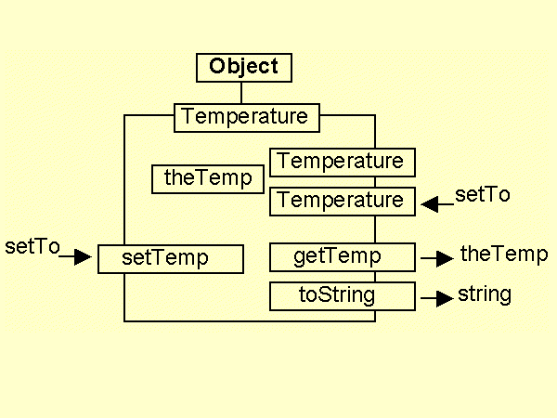
Temperature class diagram

Slide 2
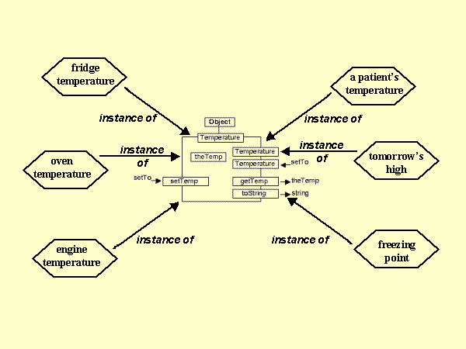
Temperature instances

Slide 3
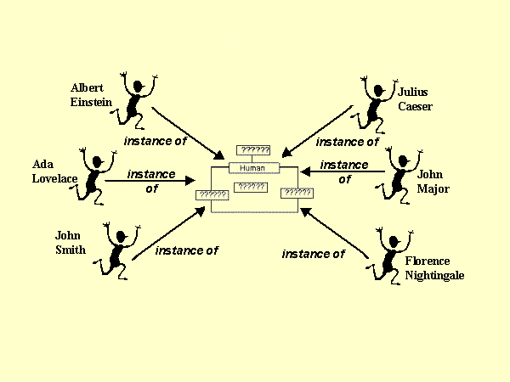
The Human class!

Slide 4
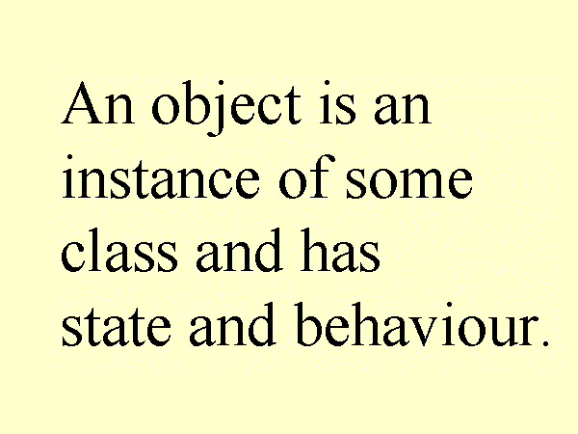
An object is ...

Slide 5
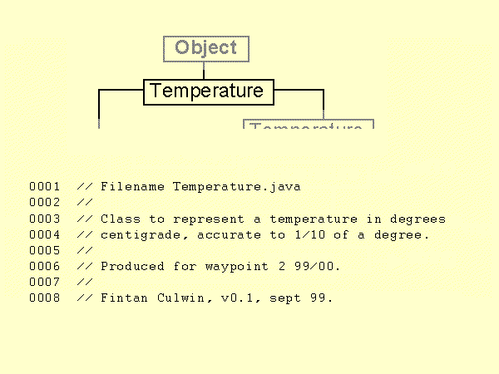
Temperature class header

Slide 6
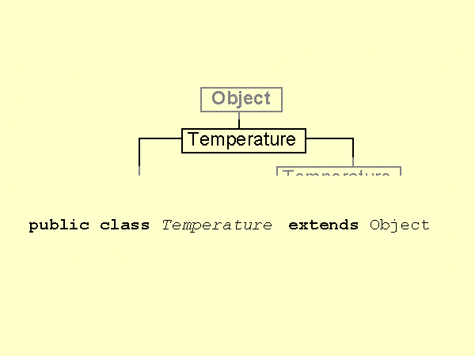
Temperature class declaration

Slide 7
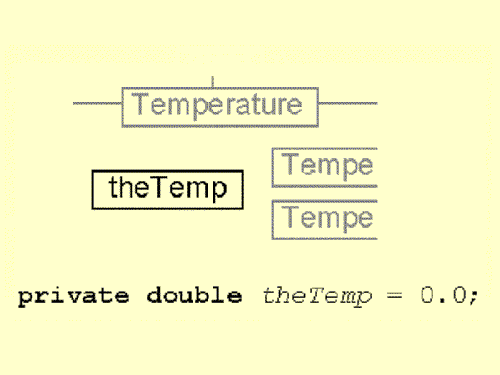
Temperature instance attribute

Slide 8
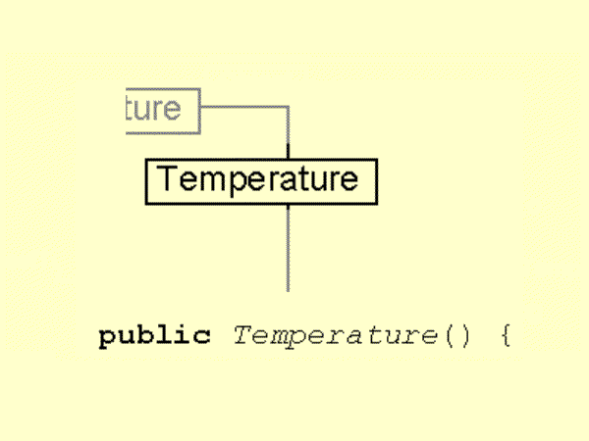
Temperature default constructor 1

Slide 9
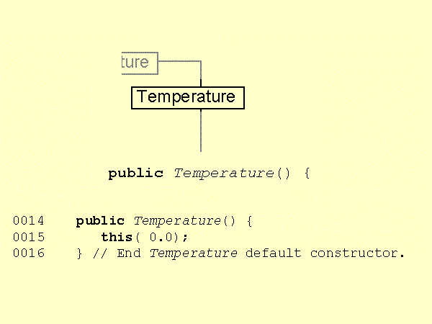
Temperature default constructor 2

Slide 10
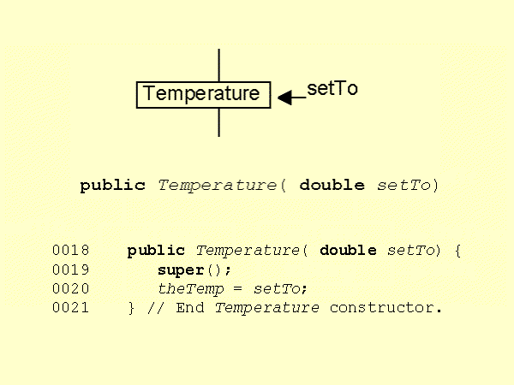
Temperature alternative constructor

Slide 11
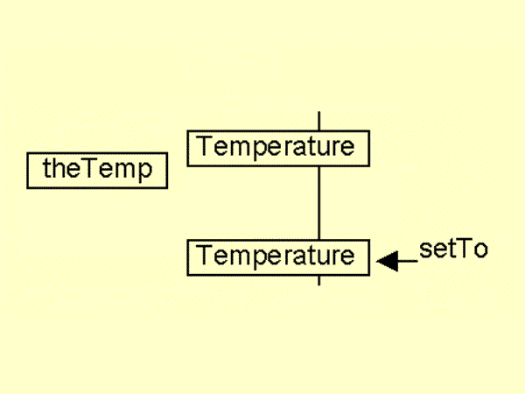
Temperature construction

Slide 12
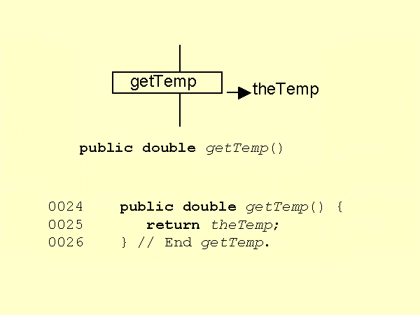
Temperature getTemp() method

Slide 13
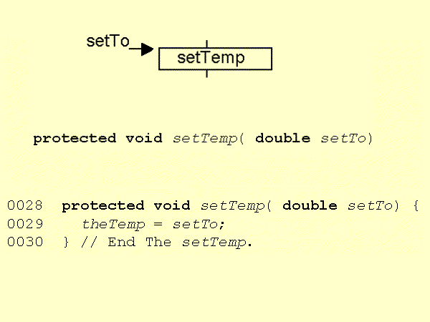
Temperature setTemp() method

Slide 14
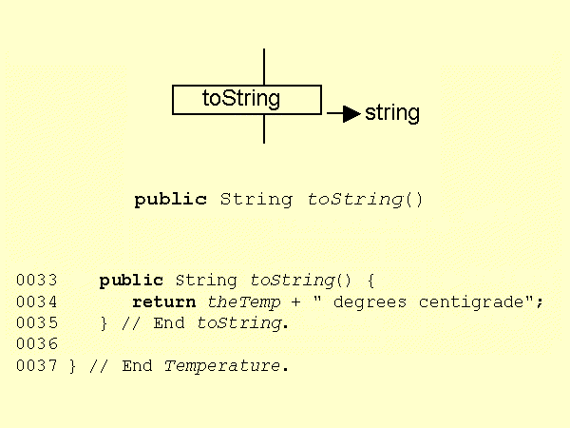
Temperature toString() method

Slide 15
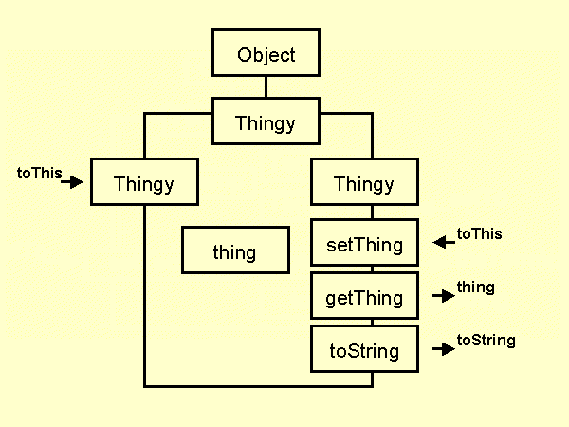
Thingy class diagram

Slide 16
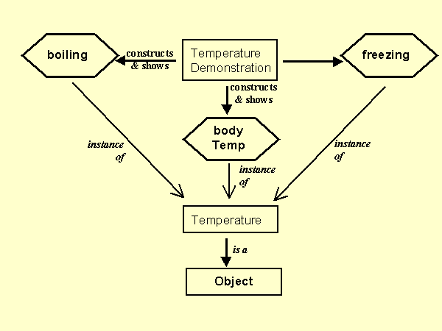
TemperatureDemonstration - instance diagram

Slide 17

TemperatureDemonstration header
0001 // Filename TemperatureDemonstration.java
0002 //
0003 // Demonstration client for the Temperature
0004 // class.
0005 //
0006 // Produced for waypoint 2 99/00.
0007 //
0008 // Fintan Culwin, v0.1, sept 99.
0009
0010 public class TemperatureDemonstration extends Object {

Slide 18
TemperatureDemonstration main() method 1
0012 public static void main( String[] args) {
0013
0014 Temperature freezing = null;
0015 Temperature boiling = null;
0016 Temperature bodyHeat = null;
0017
0018 System.out.println( "\n\nTemperature Demonstration\n\n");
0019
0020 System.out.println( "This demonstration will construct and display");
0021 System.out.println( "Three different instances of the Temp~ class.");
0022
0023 System.out.println( "\nConstrucing ... \n");
Temperature Demonstration
This demonstration will construct and display
Three different instances of the Temperature class.
Construcing ...

Slide 19
TemperatureDemonstration main() method 2
0025 freezing = new Temperature();
0026 boiling = new Temperature( 100.0);
0027 bodyHeat = new Temperature( 37.8);

Slide 20
TemperatureDemonstration main() method 3
0029 System.out.println( "\nConstructed, showing ... \n");
0030
0031 System.out.println( "Freezing is " + freezing.toString() );
0032 System.out.println( "Boiling is " + boiling.toString());
0033 System.out.println( "Body Heat is " + bodyHeat);
0034 } // End main.
0035
0036 } // End TemperatureDemonstration.
Constructed, showing ...
Freezing is 0.0 degrees centigrade
Boiling is 100.0 degrees centigrade
Body Heat is 37.8 degrees centigrade

